Slide 1

Database Systems:
Design, Implementation, and Management
Tenth Edition
Chapter 2
Data Models
Database Systems, 10th Edition

Slide 2
Introduction
Designers, programmers, and end users see data in different ways
Different views of same data lead to designs that do not reflect organization’s operation
Data modeling reduces complexities of database design
Various degrees of data abstraction help reconcile varying views of same data
Database Systems, 10th Edition
Notes:
1. Different Perspectives on Data
Designers: They focus on how to structure the database effectively, looking at how data will be stored and organized.
Programmers: They are concerned with how to access and manipulate data using code, emphasizing performance and integration with applications.
End Users: They interact with the data through user interfaces, seeking information that is relevant to their tasks, often without needing to understand the underlying complexities.
2. Consequences of Different Views
When designers, programmers, and end users have different perspectives, it can lead to discrepancies in how data is represented and used. For instance:
A designer might create a complex schema that is efficient for storage but hard for end users to navigate.
Programmers might optimize for speed but overlook usability for end users.
These differences can result in designs that do not align with the actual operations and needs of the organization, leading to inefficiencies and frustration.
3. Data Modeling as a Solution
Data Modeling: This process involves creating abstract representations of data structures, which can help bridge the gap between different perspectives. By using diagrams and models, designers can visualize data relationships and structure in a way that’s easier for others to understand.
It reduces complexity by providing a clear framework for how data should be organized and how entities relate to one another, ensuring everyone is on the same page.
4. Degrees of Data Abstraction
Data Abstraction: This refers to the process of simplifying complex data structures into more manageable forms. Different levels of abstraction can help reconcile the varying views:
Conceptual Model: This is a high-level view that captures the overall structure and relationships without delving into technical details (useful for stakeholders).
Logical Model: This represents the structure in more detail but still independent of physical considerations (useful for designers and programmers).
Physical Model: This outlines how the data will be physically stored in the database (important for programmers and database administrators).
By using these different levels of abstraction, everyone involved can find a model that suits their needs while ensuring consistency across the board.

Slide 3
Data Modeling and Data Models
Data models
  Relatively simple representations of complex real-world data structures
    Often graphical
Model: an abstraction of a real-world object or event
  Useful in understanding complexities of the real-world environment
Data modeling is iterative and progressive
Database Systems, 10th Edition
Notes:
Relational Data Model:
Description: Organizes data into tables (relations) with rows and columns.
Example: A database for a library could have tables like Books, Authors, and Borrowers, with relationships defined through foreign keys.
Entity-Relationship Model (ER Model):
Description: Uses entities (objects) and relationships to represent data.
Example: A university database might include entities like Student, Course, and Instructor, along with relationships such as enrolls_in and teaches.
Hierarchical Data Model:
Description: Data is organized in a tree-like structure with parent-child relationships.
Example: An organizational chart where each department (parent) can have multiple employees (children).
https://www.qlik.com/us/data-modeling
https://vertabelo.com/blog/types-data-models/
1. Simple Representations of Complex Structures
Data Models: They simplify complex real-world data structures into more understandable forms. For example, modeling a university system involves abstracting details about students, courses, and relationships into a structured format that is easier to analyze and work with.
2. Often Graphical
Graphical Representation: Data models are frequently visualized through diagrams (like ER diagrams, UML diagrams, etc.), which help illustrate relationships, entities, and attributes. This visual aspect makes it easier for stakeholders to understand the data structure at a glance, regardless of their technical background.
3. Abstraction of Real-World Objects or Events
Model: A model acts as an abstraction, meaning it focuses on essential characteristics while omitting unnecessary details. For instance, a model of a Customer might include attributes like CustomerID, Name, and Email, but not delve into how a customer interacts with a store.
4. Understanding Complex Real-World Environments
Utility: By creating data models, organizations can better understand the complexities of their environments. This understanding aids in decision-making, system design, and identifying relationships between different entities in the data.
5. Iterative and Progressive Nature of Data Modeling
Iterative Process: Data modeling is not a one-time activity; it’s iterative. As new requirements emerge or as more information becomes available, models can be refined and adjusted. For example, initial models may miss certain relationships or entities, which can be identified and added in subsequent iterations.
Progressive Development: The process is also progressive, meaning models evolve over time. Starting with high-level models, you can gradually add detail and complexity as understanding deepens, which helps ensure that the model remains aligned with real-world requirements.

Slide 4
Data Model Basic Building Blocks
Entity: anything about which data are to be collected and stored
Attribute: a characteristic of an entity
Relationship: describes an association among entities
  One-to-many (1:M) relationship
  Many-to-many (M:N or M:M) relationship
  One-to-one (1:1) relationship
Constraint: a restriction placed on the data
Database Systems, 10th Edition
Notes:
1. Entity
Definition: An entity is any object, person, place, or concept about which data is collected and stored.
Example: In a school database, entities could include Student, Teacher, and Course. Each entity represents a distinct object that has data associated with it.
2. Attribute
Definition: An attribute is a characteristic or property of an entity that provides more information about it.
Example: For the Student entity, attributes might include StudentID, Name, DateOfBirth, and Major. Each attribute gives specific details about the student.
3. Relationship
Definition: A relationship describes how two or more entities are associated with one another.
Example: A relationship could be EnrolledIn, which links Student and Course entities, indicating that students can be enrolled in courses.
Types of Relationships
One-to-Many (1
)
Definition: In a one-to-many relationship, a single instance of one entity can be associated with multiple instances of another entity, but not vice versa.
Example: A Teacher can teach many Courses, but each Course is taught by only one Teacher.
Many-to-Many (M
or M
)
Definition: In a many-to-many relationship, multiple instances of one entity can be associated with multiple instances of another entity.
Example: Students can enroll in many Courses, and each Course can have many Students. This relationship requires a junction table to manage the associations.
One-to-One (1:1)
Definition: In a one-to-one relationship, a single instance of one entity is associated with a single instance of another entity.
Example: Each Person might have one Passport, and each Passport belongs to one Person.
4. Constraint
Definition: A constraint is a rule or restriction placed on the data to ensure its integrity and validity.
Example: A constraint might specify that StudentID must be unique, meaning no two students can have the same ID. Other constraints could include data type restrictions (like requiring that DateOfBirth must be a valid date) or referential integrity (ensuring that relationships between entities remain valid).

Slide 5
Business Rules
Descriptions of policies, procedures, or principles within a specific organization
  Apply to any organization that stores and uses data to generate information
Description of operations to create/enforce actions within an organization’s environment
  Must be in writing and kept up to date
  Must be easy to understand and widely disseminated
Describe characteristics of data as viewed by the company
Database Systems, 10th Edition
Notes:
1. Descriptions of Policies, Procedures, or Principles
Definition: This refers to the formal documentation that outlines the rules and guidelines an organization follows in managing its data.
Example: A policy might specify how sensitive data should be handled, including who has access to it and how it should be protected.
2. Application to Any Organization
Universality: These policies are relevant to any organization that collects, stores, and uses data, regardless of its size or industry.
Importance: Whether it’s a healthcare provider, a retail company, or a nonprofit, all organizations need clear guidelines for data management to ensure compliance and effective use.
3. Description of Operations
Operational Framework: The policies detail the specific operations and processes that an organization must follow to enforce data management practices.
Example: This could include procedures for data entry, data storage, data sharing, and data retention.
4. Written and Up-to-Date
Documentation: It is essential for these policies to be documented in writing. This ensures that there is a clear reference for employees and stakeholders.
Regular Updates: Policies must be regularly reviewed and updated to reflect changes in laws, regulations, or organizational practices.
5. Easy to Understand and Disseminated
Clarity: Policies should be written in straightforward language so that all employees can easily understand them, regardless of their technical expertise.
Communication: It’s crucial for these policies to be widely shared within the organization so that everyone is aware of the guidelines and their responsibilities.
6. Characteristics of Data
Data Characteristics: These policies often describe how data is viewed within the organization, including its quality, security, privacy, and compliance considerations.
Example: A policy might define what constitutes "sensitive data," how it should be categorized, and the specific controls required to protect it.

Slide 6
Translating Business Rules into Data Model Components
Nouns translate into entities
Verbs translate into relationships among entities
Relationships are bidirectional
Two questions to identify the relationship type:
  How many instances of B are related to one instance of A?
  How many instances of A are related to one instance of B?
Database Systems, 10th Edition
Notes:
nouns like Book, Author, and Member would translate into entities
In the same library system, the verb "borrows" could describe a relationship between the Member entity and the Book entity,
if Member borrows Book, you can say a Book is borrowed by a Member. This reflects the interconnected nature of the entities.
If asking how many Books can be borrowed by one Member, the answer might be "many," indicating a one-to-many relationship.
asking how many Members can borrow one Book, the answer might also be "many," indicating a many-to-many relationship.

Slide 7
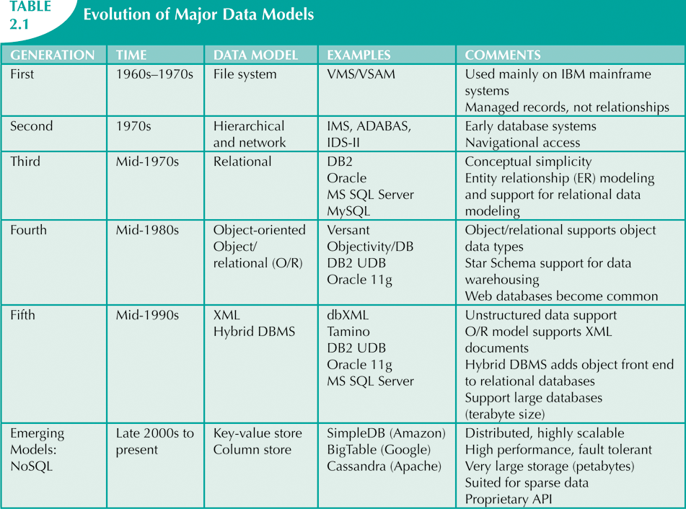
The Evolution of Data Models
Database Systems, 10th Edition

Slide 8
The Relational Model
Developed by E.F. Codd (IBM) in 1970
Table (relations)
  Matrix consisting of row/column intersections
  Each row in a relation is called a tuple
Relational models were considered impractical in 1970
Model was conceptually simple at expense of computer overhead
Database Systems, 10th Edition
Notes:
A relational database is a type of database that stores data in a structured format, using rows and columns. It is based on the relational model introduced by E.F. Codd in the 1970s. Here are some key characteristics and components of relational databases:
Key Characteristics
Tables: Data is organized into tables (or relations), where each table consists of rows (records) and columns (attributes). Each table typically represents a specific entity (e.g., Customers, Orders).
Primary Keys: Each table has a primary key, which is a unique identifier for each record in the table. This ensures that no two rows can have the same key value.
Foreign Keys: These are attributes that create a link between two tables. A foreign key in one table refers to the primary key in another table, establishing a relationship between the two.
Structured Query Language (SQL): Relational databases use SQL as the standard language for querying and manipulating data. SQL allows users to perform operations like retrieving, inserting, updating, and deleting data.
Normalization: Relational databases often undergo normalization, a process that organizes data to reduce redundancy and improve data integrity. This involves dividing larger tables into smaller, related tables.
Relationships: Relationships between tables can be categorized as:
One-to-One (1:1): One record in Table A relates to one record in Table B.
One-to-Many (1
): One record in Table A can relate to many records in Table B.
Many-to-Many (M
): Records in Table A can relate to multiple records in Table B and vice versa.
Benefits
Data Integrity: Enforced through primary and foreign keys, ensuring that relationships between data are consistent.
Flexibility: Tables can be modified without affecting others, allowing for easy data management.
Powerful Querying: SQL provides powerful capabilities to manipulate and retrieve data as needed.
Examples of Relational Database Management Systems (RDBMS)
MySQL
PostgreSQL
Oracle Database
Microsoft SQL Server

Slide 9
The Relational Model (cont’d.)
Relational data management system (RDBMS)
  Hides complexity from the user
Relational diagram
  Representation of entities, attributes, and relationships
Relational table stores collection of related entities
Database Systems, 10th Edition
Notes:
https://en.wikipedia.org/wiki/Entity%E2%80%93relationship_model#/media/File:ER_Diagram_MMORPG.png
https://en.wikipedia.org/wiki/Entity%E2%80%93relationship_model
https://www.lucidchart.com/pages/er-diagrams
an RDBMS allows for more complex queries and relationships between entities.
One of the strengths of an RDBMS is that it abstracts the complexities of how data is stored and managed. Users interact with data through high-level queries (like SQL) without needing to understand the underlying structures.
Definition: A relational table is a structured format for storing data where each table represents an entity and consists of rows (records) and columns (attributes).
Storage of Related Entities: Each table can store a collection of related entities. For example, a Students table may include columns like StudentID, Name, and Major, with each row representing a different student.

Slide 10
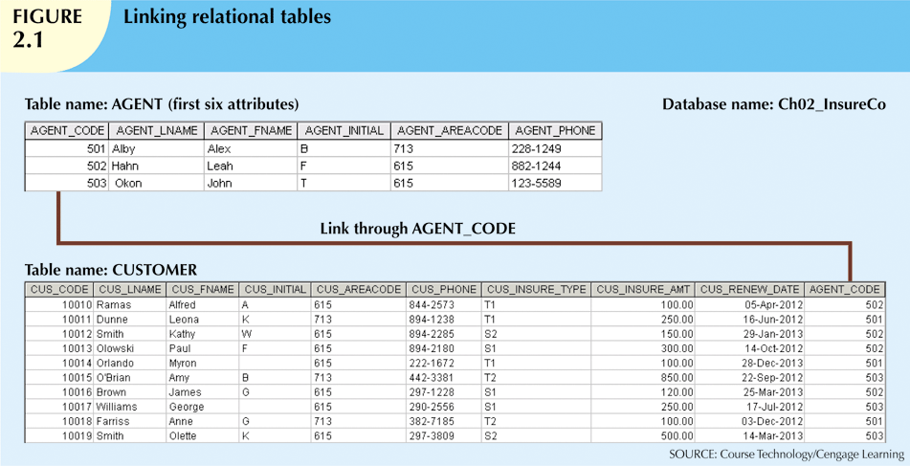
Database Systems, 10th Edition

Slide 11
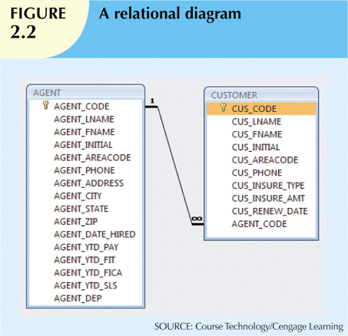
Database Systems, 10th Edition

Slide 12
The Relational Model (cont’d.)
SQL-based relational database application involves three parts:
  End-user interface
    Allows end user to interact with the data
  Set of tables stored in the database
    Each table is independent from another
    Rows in different tables are related based on common values in common attributes
  SQL “engine”
    Executes all queries
Database Systems, 10th Edition
Notes:
1. End-User Interface
Definition: This is the part of the application that allows users to interact with the database. It can take various forms, including graphical user interfaces (GUIs) or command-line interfaces.
Functionality: The end-user interface enables users to perform actions such as:
Entering and updating data
Running queries to retrieve specific information
Viewing reports and data visualizations
Importance: A user-friendly interface simplifies interactions, allowing non-technical users to access and manage data effectively.
2. Set of Tables Stored in the Database
Definition: The core of a relational database consists of multiple tables, each representing a specific entity (like Customers, Orders, or Products).
Independence of Tables: Each table is independent, meaning they can exist separately without depending on one another. This modularity allows for flexibility in managing data.
Relationships Between Tables: Although tables are independent, they can be related through common attributes (columns). For example:
A Customers table may have a CustomerID, and an Orders table can also have a CustomerID. This common value links the two tables, allowing you to associate specific orders with the corresponding customers.
3. SQL Engine
Definition: The SQL engine is the component responsible for executing SQL queries against the database. It processes the commands sent from the end-user interface and performs the required operations on the tables.
Functions of the SQL Engine:
Query Execution: It translates SQL statements into actions that manipulate the database, such as retrieving, inserting, updating, or deleting data.
Optimization: The SQL engine often includes optimization techniques to improve the performance of queries, ensuring that data retrieval is efficient.
Transaction Management: It manages transactions to ensure data integrity and consistency, allowing users to perform multiple operations as a single unit (either all succeed or all fail).

Slide 13
The Entity Relationship Model
Widely accepted standard for data modeling
Introduced by Chen in 1976
Graphical representation of entities and their relationships in a database structure
Entity relationship diagram (ERD)
  Uses graphic representations to model database components
  Entity is mapped to a relational table
Database Systems, 10th Edition
Notes:
1. Widely Accepted Standard for Data Modeling
Definition: This refers to a common framework used to represent the structure of a database and the relationships between its components. It provides a standardized way to visualize data, making it easier for designers and stakeholders to understand.
Importance: A standardized approach helps ensure consistency and clarity in data modeling across different projects and organizations.
2. Introduced by Chen in 1976
Origin: The Entity-Relationship model was introduced by Peter Chen in his seminal paper in 1976. This model revolutionized how data is conceptualized and organized within databases.
Impact: Chen's work laid the foundation for modern database design, influencing many subsequent methodologies and tools for data modeling.
3. Graphical Representation of Entities and Their Relationships
Purpose: The main goal of ER modeling is to visually represent the entities within a database and the relationships between them. This helps stakeholders quickly understand the structure and organization of data.
Example: In an ER diagram, you might see entities like Customer, Order, and Product, along with lines connecting them to illustrate their relationships.
4. Entity Relationship Diagram (ERD)
Definition: An ERD is a specific type of diagram that represents the entities, their attributes, and the relationships between those entities in a database structure.
Components:
Entities: Represented as rectangles, indicating objects or concepts (e.g., Customer).
Attributes: Shown as ovals connected to their respective entities, detailing characteristics (e.g., CustomerID, Name).
Relationships: Illustrated as lines connecting entities, often annotated to show the nature of the relationship (e.g., one-to-many, many-to-many).
5. Mapping Entity to a Relational Table
Mapping: In a relational database, each entity in the ERD is typically mapped to a relational table. For example, the Customer entity might correspond to a Customers table, where each attribute becomes a column in that table.
Benefits: This mapping ensures that the logical structure represented in the ERD is translated into a physical structure in the database, facilitating data storage and retrieval.

Slide 14
The Entity Relationship Model (cont’d.)
Entity instance (or occurrence) is row in table
Entity set is collection of like entities
Connectivity labels types of relationships
Relationships are expressed using Chen notation
  Relationships are represented by a diamond
  Relationship name is written inside the diamond
Crow’s Foot notation used as design standard in this book
Database Systems, 10th Edition
Notes:
1. Entity Instance (or Occurrence)
Definition: An entity instance (or occurrence) refers to a single, specific example of an entity that exists in a database.
Example: In a Customer table, each row represents an individual customer. For instance, one row might contain the details for "John Doe," making that particular row an instance of the Customer entity.
2. Entity Set
Definition: An entity set is a collection of similar entities that share the same attributes. Essentially, it’s the table itself in a relational database.
Example: The Customer entity set includes all customer instances (rows) in the Customer table. Each row has attributes like CustomerID, Name, and Email, representing different customers.
3. Connectivity Labels
Definition: Connectivity refers to the nature of the relationship between entities and is often labeled to describe how they are related.
Example: Connectivity can indicate types of relationships like:
One-to-One (1:1): Each instance of entity A is related to exactly one instance of entity B.
One-to-Many (1
): Each instance of entity A can relate to multiple instances of entity B, but each instance of entity B relates to only one instance of entity A.
Many-to-Many (M
): Instances of entity A can relate to multiple instances of entity B and vice versa.
4. Chen Notation
Definition: Chen notation is a specific method for representing entities, attributes, and relationships in ER diagrams.
Representation:
Entities: Represented as rectangles.
Attributes: Shown as ovals connected to their respective entities.
Relationships: Represented by diamonds, with the relationship name written inside the diamond.
5. Crow’s Foot Notation
Definition: Crow’s Foot notation is a more modern and widely used design standard for ER diagrams. It provides a clear way to represent cardinality and relationships visually.
Representation:
Relationships are depicted with lines that have “crow's foot” symbols at one or both ends to indicate the type of relationship (e.g., one or many).
This notation allows for quick recognition of relationship types and cardinality.

Slide 15
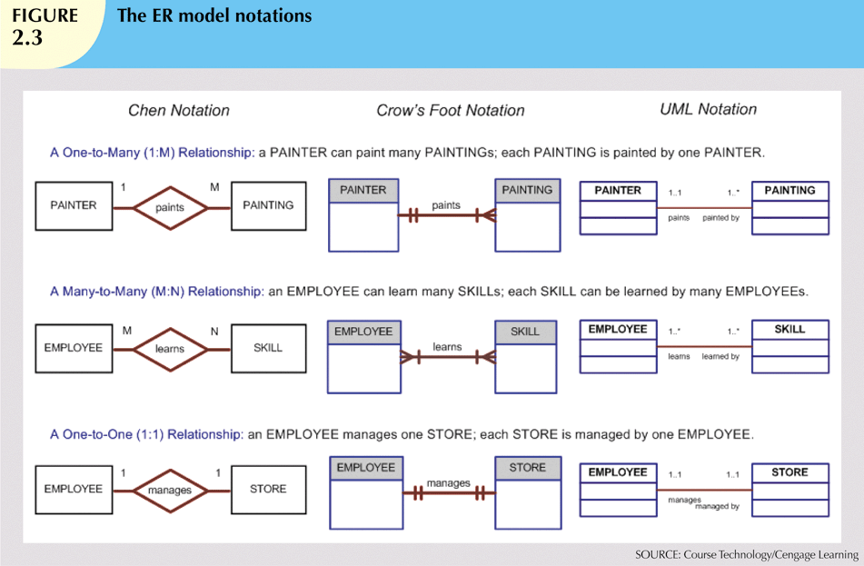
Database Systems, 10th Edition

Slide 16
Data Models: A Summary
Common characteristics:
  Conceptual simplicity with semantic completeness
  Represent the real world as closely as possible
  Real-world transformations must comply with consistency and integrity characteristics
Each new data model capitalized on the shortcomings of previous models
Some models better suited for some tasks
Database Systems, 10th Edition

